Slide 1

ECOMMERCE
DR. SUBRATA BHOWMICK

Slide 2
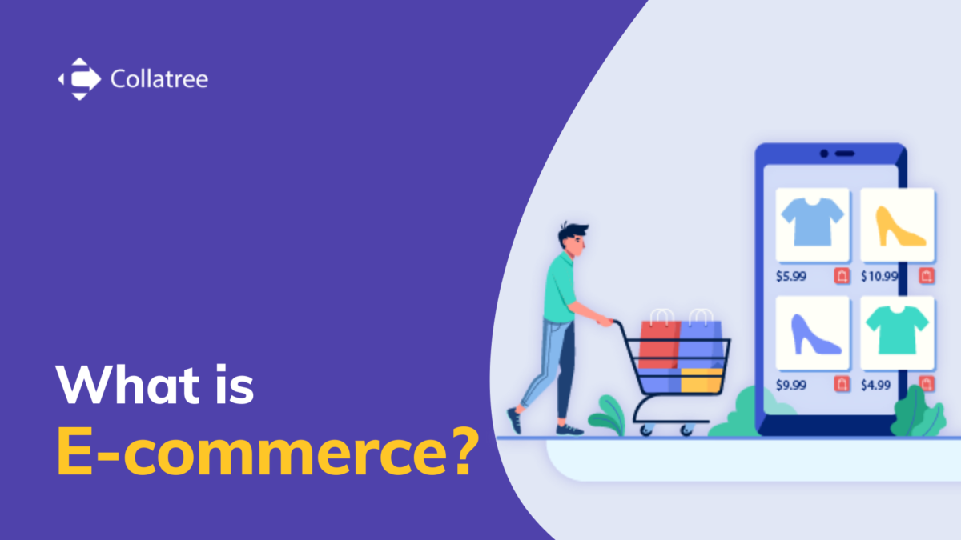
What Is Electronic Commerce (E-commerce)?
Electronic commerce, or e-commerce, is the buying and selling of goods and services over the internet. E-commerce can be conducted on computers, tablets, smartphones, and other smart devices. Nearly every imaginable product and service is now available through e-commerce, and it has upended how many companies and entire industries do business.

Slide 3
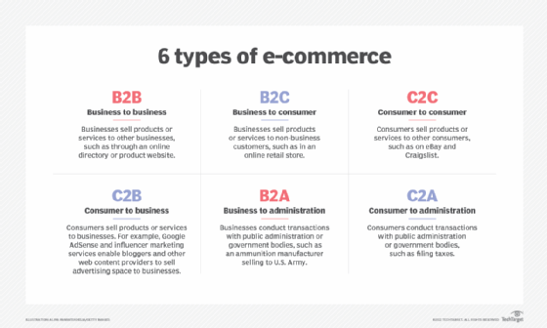

Slide 4
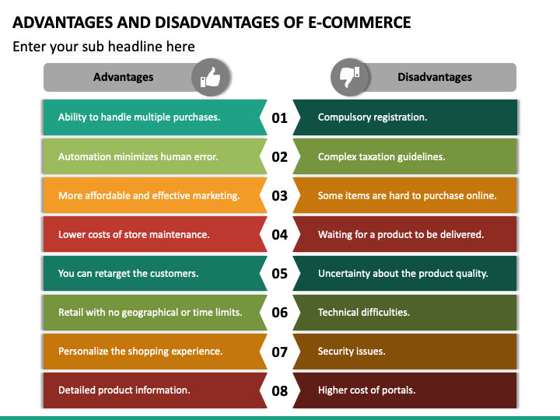

Slide 5
MODELS OF ECOMMERCE
Selling your products to customers
Selling your products directly to customers helps you cut costs by eliminating middlemen. The direct-to-customer model is a great way for online stores to build a loyal relationships with customers, and you can easily customize your customer experience
. Online retailers like Warby Parker, Glossier, and Casper practice this type of e-business model.

Slide 6
Selling "White label" products
White labeling is a business model and strategy that involves branding a third-party product and selling it as your product. White labeling is common in the health and fashion industry.
An example is a cosmetic brand that buys a particular type of
body cream from a third-party brand and sells it under its Name.
The image and design of the cosmetic brand will be presented on the product, depicting their ownership.

Slide 7
3. Wholesaling
Wholesaling is an ecommerce model and strategy that involves selling goods in large quantities to businesses at a discounted price.
This model is common to manufacturers and online retailers. Venturing into wholesaling requires huge capital and a large inventory. However, the model has high risks and thin profit margins. Many B2B brands and a few B2C companies apply this business strategy.

Slide 8
4. Dropshipping
Want to sell products without holding inventory? Drop shipping is your answer. Drop shipping is an ecommerce revenue model that allows you to market and sell items by acting as an intermediary between a buyer and a supplier. You eliminate the costs of holding inventory, warehousing, and shipping.

Slide 9
You can set up an ecommerce website and display products of different brands with your own added price. When a buyer places an order, you notify the supplier who handles the tracking and delivery of the product, then you gain a commission from the price. You are only responsible for running ads and getting traffic to your ecommerce site.

Slide 10
5. Selling by subscriptions
A subscription-based ecommerce revenue model enables customers to buy and subscribe to a service or product for a defined period - usually lasting for a month or year. Most software companies adopt the subscription e-business model, including Website builders, Payroll software, Accounting solutions, and many others. The model is not limited to Tech giants only, as ecommerce giants like Netflix, Blue Apron, Amazon Prime, and ButcherBox also use the model.

Slide 11
6. Using a freemium model
Freemium is an ecommerce business marketing strategy that involves making some product or service features accessible to users for free while charging a premium price for the additional features. The model is mostly used by Social media enterprises like Hootsuite, Music providers like Spotify, and Software companies that make games and mobile applications.

Slide 12
TECHNOLOGY USED IN ECOMMERCE
The Internet is the foremost important tool and the prominent resource that is being used by almost every person across the globe. It connects millions of computers, web pages, websites, and servers. Using the internet we can send emails, photos, videos, and messages to our loved ones. Or in other words, the Internet is a widespread interconnected network of computers and electronic devices(that support Internet). It creates a communication medium to share and get information online.

Slide 13
OBJECTIVE OF INTERNET
1. Global Connectivity
2. Information Sharing
3. Facilitating Communication
4.promoting ecommerce and business
5.Entertainment and media access
6. Enhancing education and learning.

Slide 14
WWW
The World Wide Web (WWW or simply the Web) is an INFORMATION TECHNOLOGY that enables content sharing over the internet through user-friendly ways meant to appeal to users beyond IT specialists and hobbyists. It allows documents and other WEB RESOURCE to be accessed over the Internet according to specific rules of the (HTTP).

