Slide 1
PRINCIPAL OF MARKETING
DR. SUBRATA BHOWMICK
ASST. PROF DEPT. OF MGMT

Slide 2
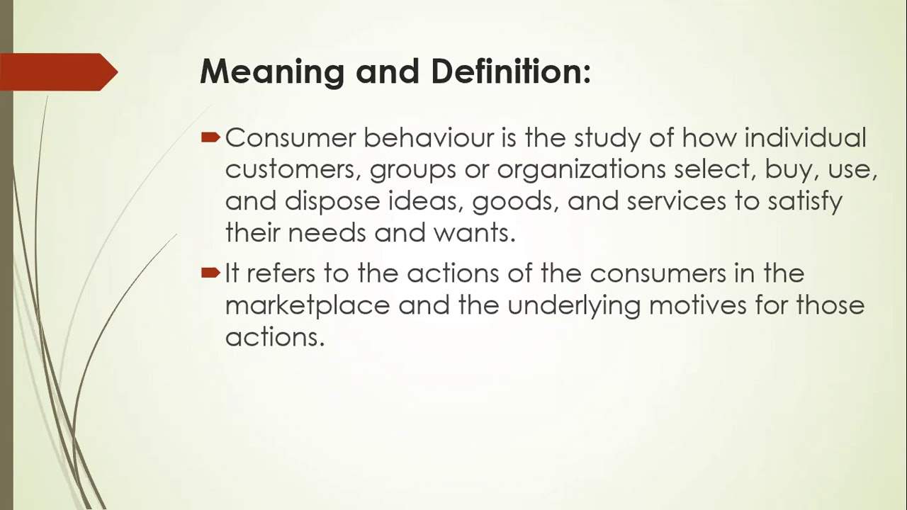

Slide 3
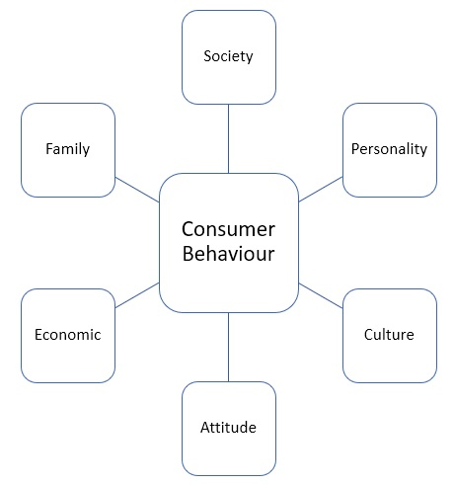

Slide 4
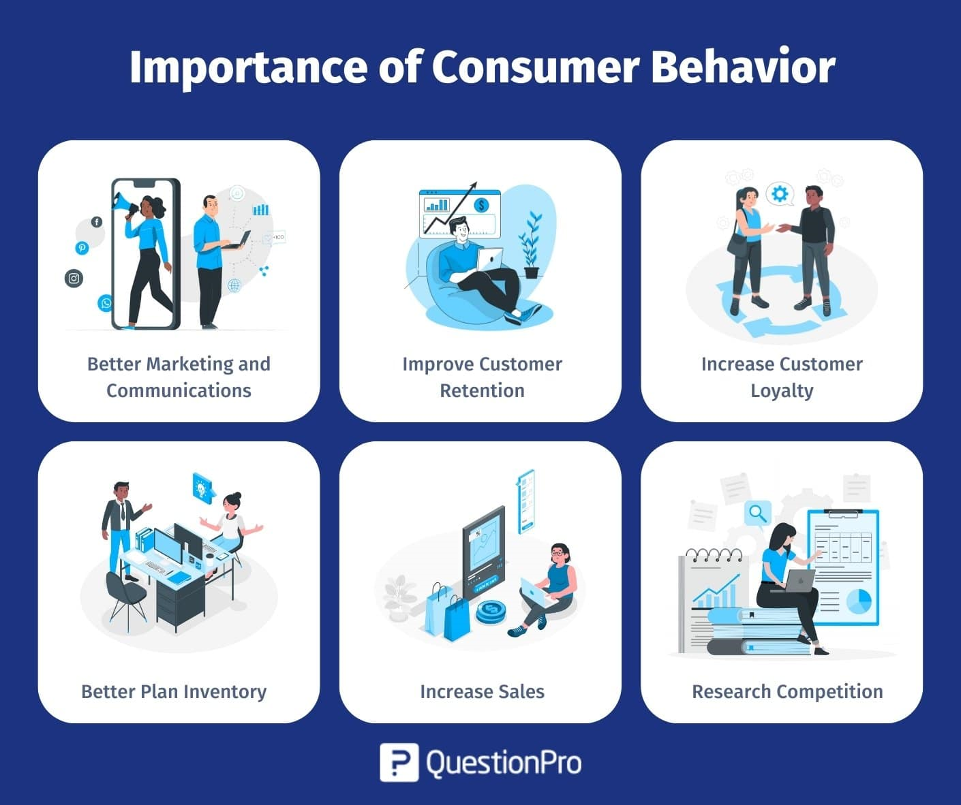

Slide 5
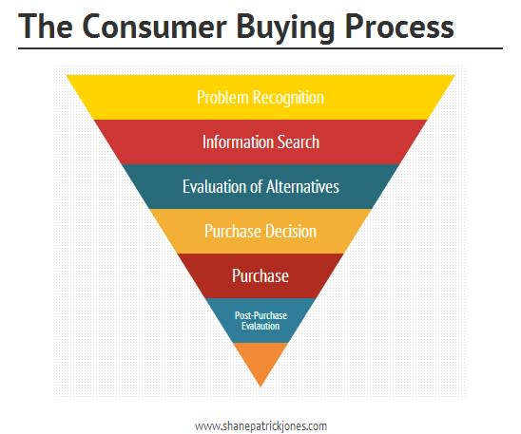

Slide 6
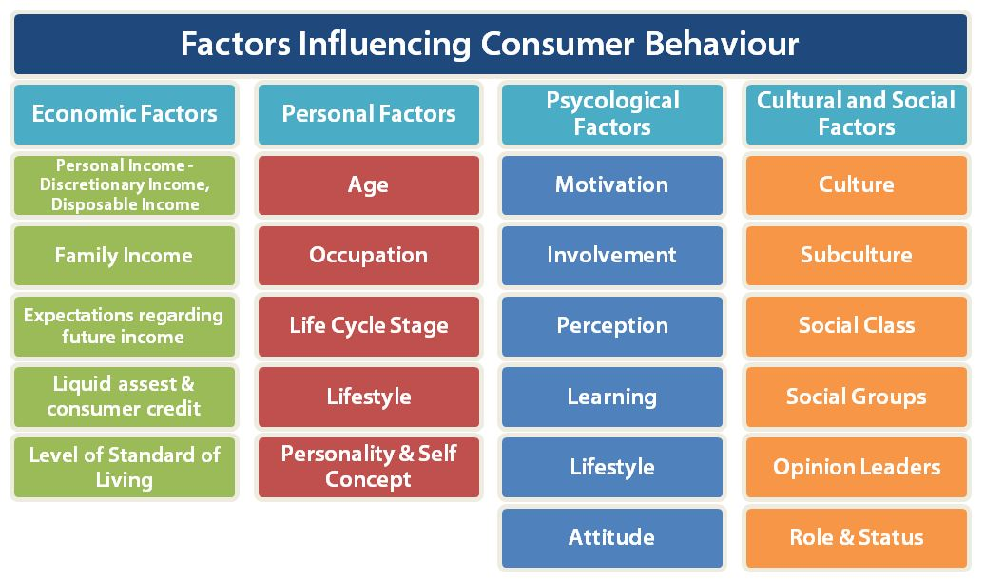

Slide 7
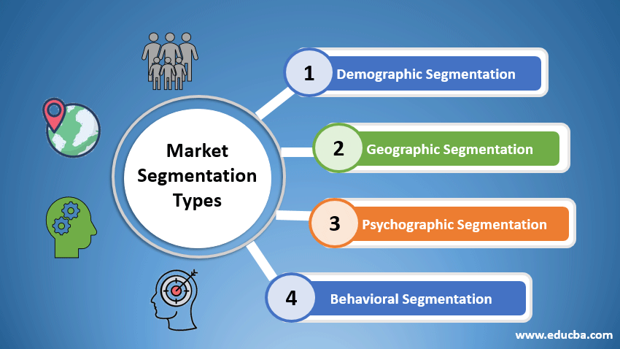

Slide 8
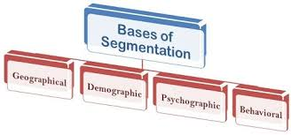

Slide 9
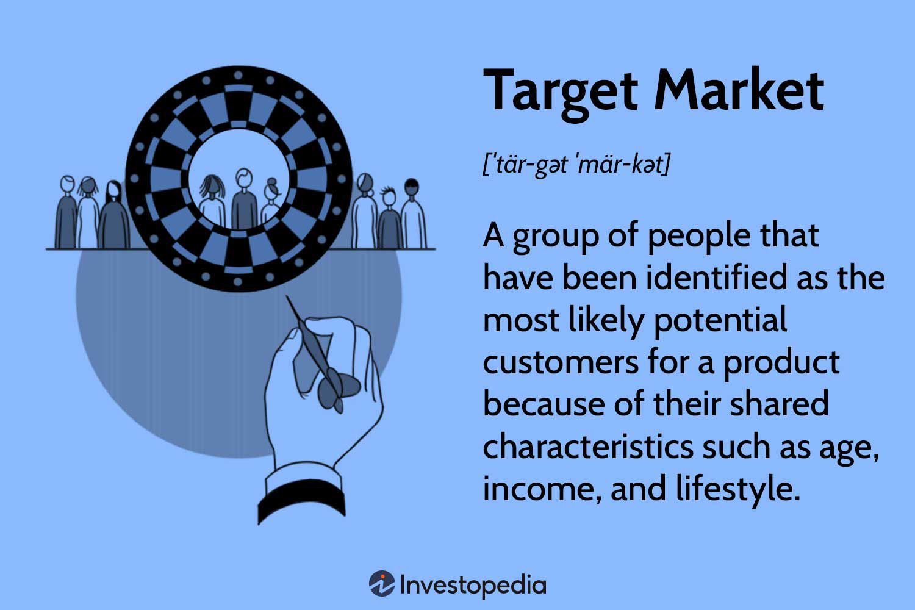

Slide 10
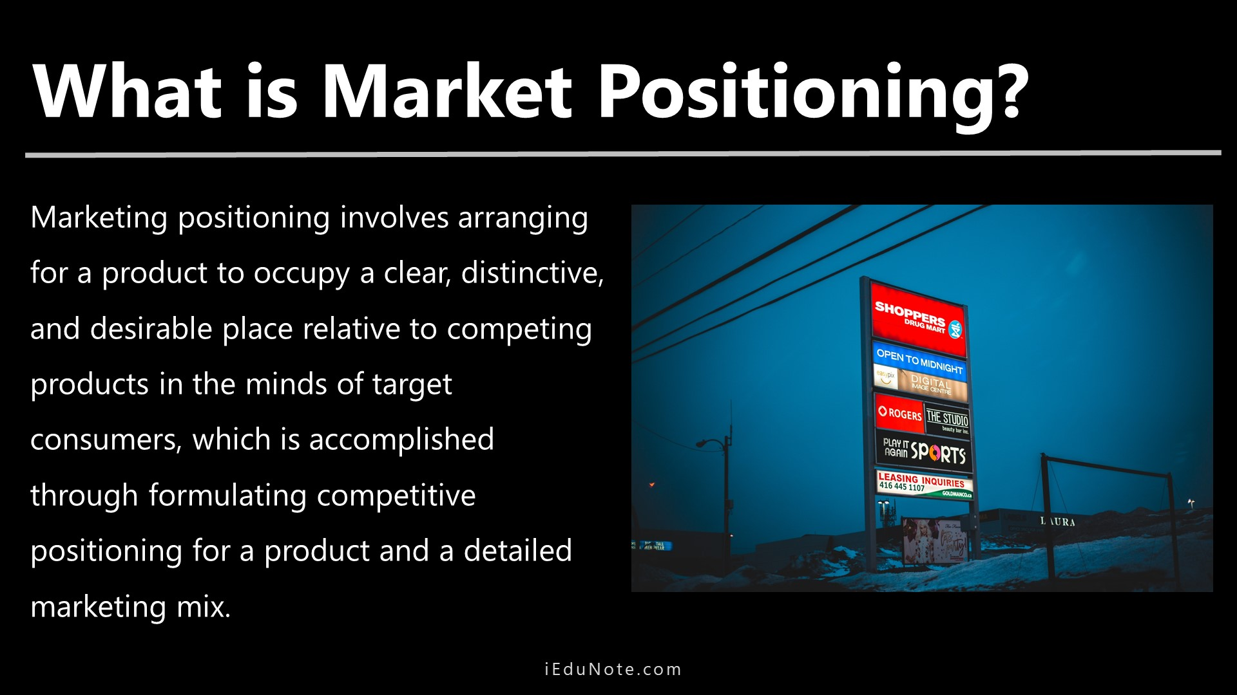

Slide 11
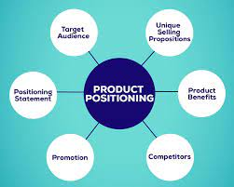

Slide 12
Product Differentiation | Market Segmentation
The process of making a product or service stand out from others in the market by emphasizing its unique features and benefits. | Dividing a broad customer base into smaller groups based on shared characteristics such as age, gender, preferences, or behaviors.
On the product or service itself. | On the customer or market.
To create a product or service that appears unique or superior in some aspect compared to competitors. | To identify and target specific groups of consumers more effectively with tailored marketing strategies.
Unique features, design, quality, functionality, and brand perception. | Demographics, psychographics, geographic location, behavioral factors.
Emphasizes the unique selling points (USPs) of the product or service. | Involves creating different marketing mix strategies for each segment.
Apple differentiates its iPhone with a unique design and ecosystem. | Nike segmented the market into athletes, casual exercisers, and sports enthusiasts.
Helps in building brand loyalty and justifying premium pricing. | Enhances marketing efficiency by focusing on specific consumer needs.

