Slide 1
PRINCIPAL AND PRACTICES OF MANAGEMENT
DR SUBRATA BHOWMICK
ASSISTANT PROFESSOR
DEPT. OF MGMT

Slide 2
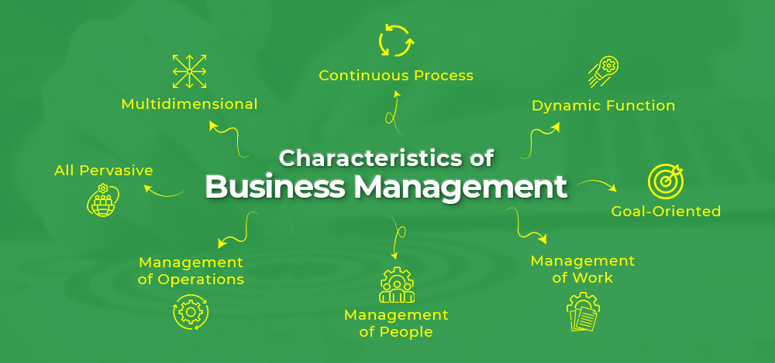

Slide 3
COORDINATION
Coordination in management is the process of organizing and aligning the efforts of an organization's departments and employees to achieve a common goal. It's a vital part of management that ensures resources are used efficiently and that there's minimal conflict.
Why is coordination important?
Efficiency: Coordination helps an organization run smoothly and efficiently.
Conflict resolution: Coordination can help reduce and resolve conflicts between employees.
Teamwork: Coordination can help promote goodwill and team spirit between employees.
Resource utilization: Coordination can help ensure that resources are used efficiently.

Slide 4
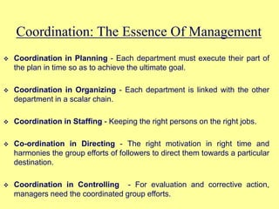

Slide 5
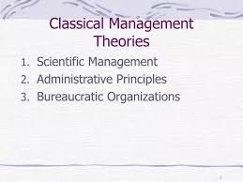

Slide 6
SCIENTIFIC MANAGEMENT
Scientific management theory is a way to improve productivity and efficiency in a workplace by using scientific methods. It was developed by American mechanical engineer Frederick Winslow Taylor.

Slide 7
Principles of scientific management
Motion study
Analyzes the movements involved in a job to reduce random movements and improve efficiency
Scientific selection and training
Matches workers to jobs based on their abilities and provides targeted training
Standardization of work processes
Establishes standard procedures to reduce errors, waste, and variability

Slide 8
Science, not rule of thumb
Analyzes every task scientifically and prohibits the use of rule of thumb or congenital ways
Differential piece wage system
Offers higher rates to employees who complete more than the standard quantity of work

Slide 9
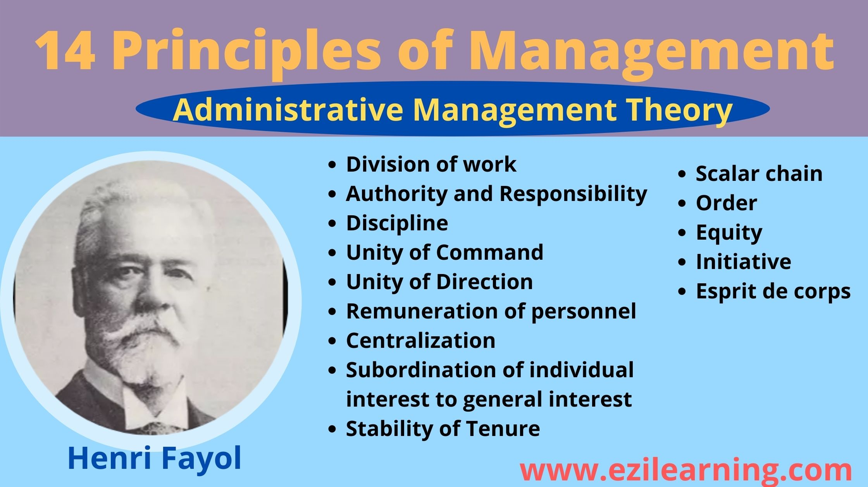

Slide 10
